Slide 1



Slide 2
Universal Recycling Law
Recycling for Multi-family housing units

Slide 3
Agenda
Understanding Universal Recycling
Recycling – What Goes In/Out
VT Rental Housing Code Updates
What’s Next? Food Scraps

Slide 4
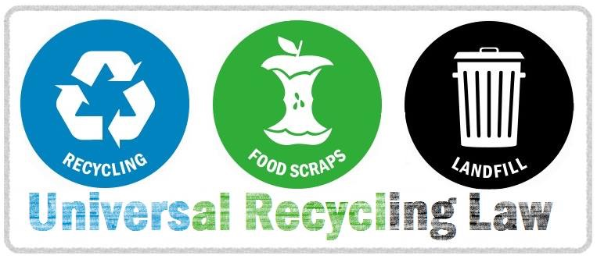
PART ONE

Slide 5
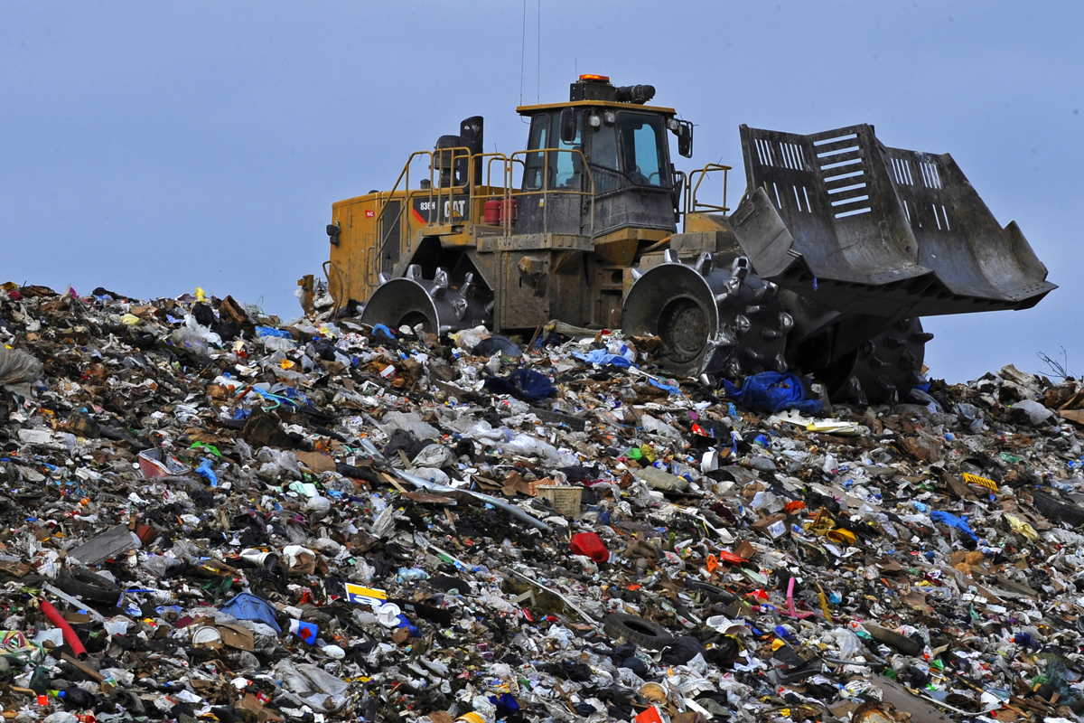
Universal Recycling changes our view of waste
from this …

Slide 6
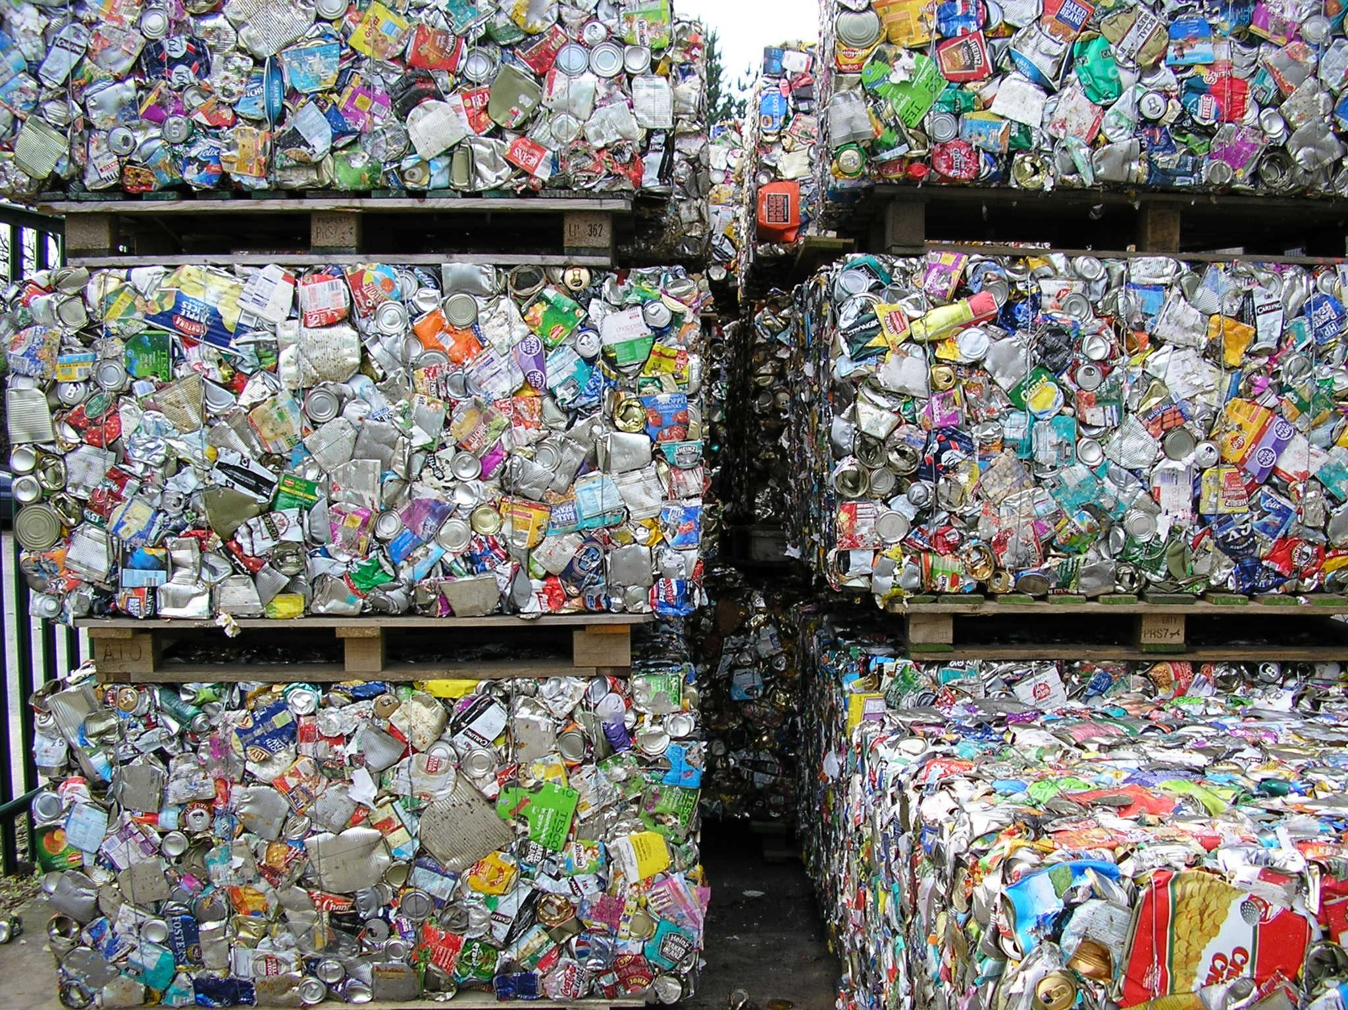
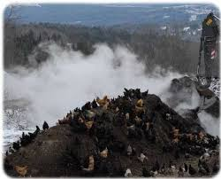
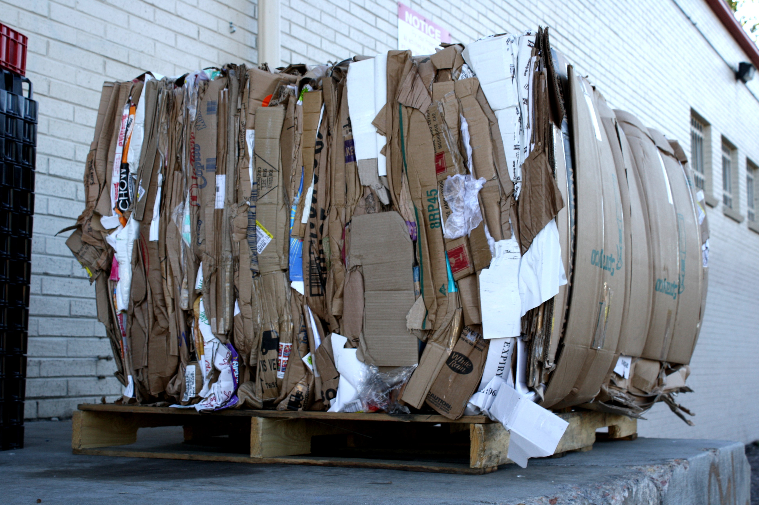

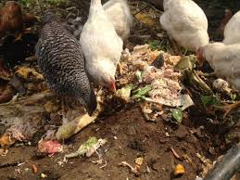
To This …

Slide 7
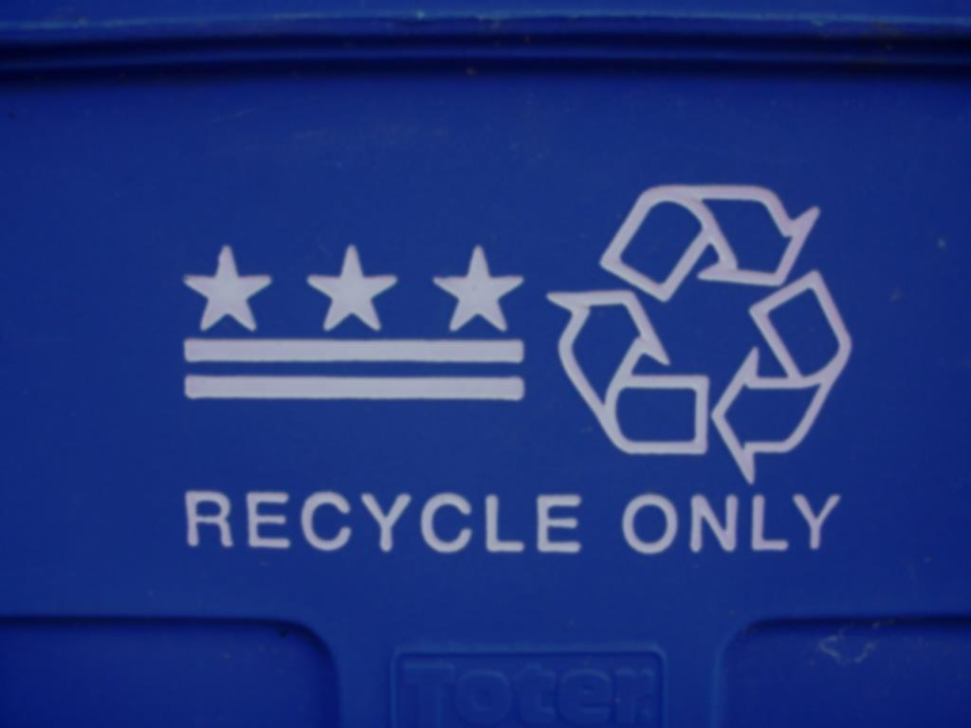
Universal Recycling Law
July 1, 2014
Transfer Stations/Drop-Off Facilities accept recyclables
No separate line item charge for recyclables
Food scrap generators of 104 tons/year (2 tons/week) must divert material to any certified facility within 20 miles

Slide 8
TIMELINE
July 1, 2015
Statewide unit based pricing
Recyclables banned from the landfill
Haulers offer recycling collection
No separate line item charge for recyclables
Public spaces have recycling containers alongside trash.
Food scrap generators of 52 tons/year must divert material to any certified facility within 20 miles

Slide 9
TIMELINE
July 1, 2016 –
Leaf, yard, and clean wood banned from the landfill
Haulers must offer leaf and yard debris collection
Food scrap generators of 26 tons/year (1/2 ton/week) must divert material to certified facility within 20 miles

Slide 10
TIMELINE
July 1, 2017
Transfer Stations/Drop-Off Facilities must accept food scraps
Haulers must offer food scrap collection
Food scrap generators of 18 tons/year (1/3 ton/week) must divert material to any certified facility within 20 miles
July 1, 2020
Food scraps banned from the landfill

Slide 11
PART TWO
Recycling
What Goes In/What Stays Out

Slide 12
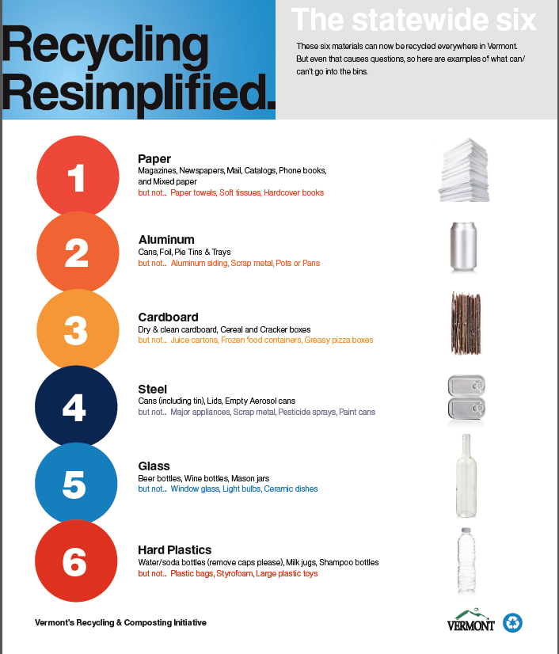
It’s Simple

Slide 13
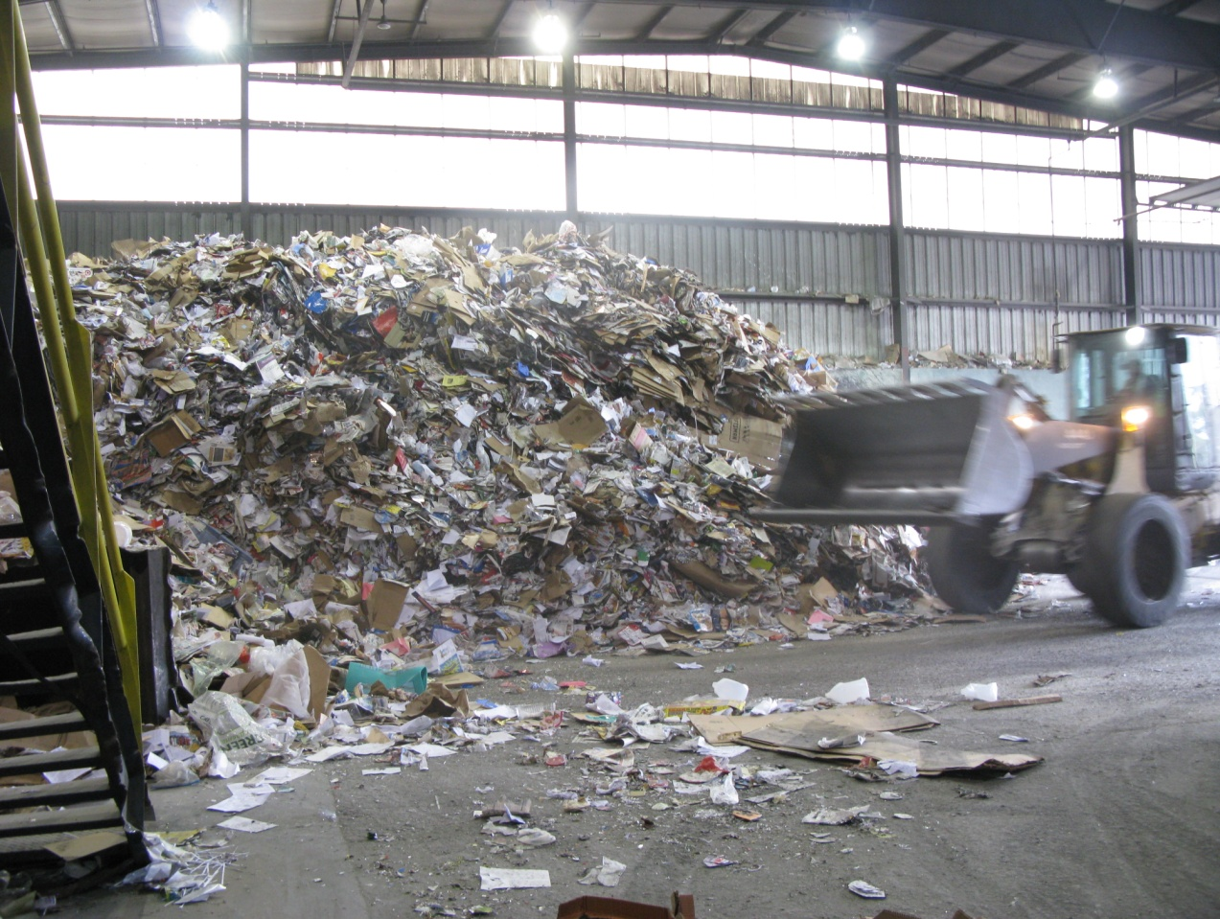
Single Stream
Easiest kind of recycling
Materials sorted at MRF
Lower value
Contamination is often high
Most common in CVSWMD

Slide 14
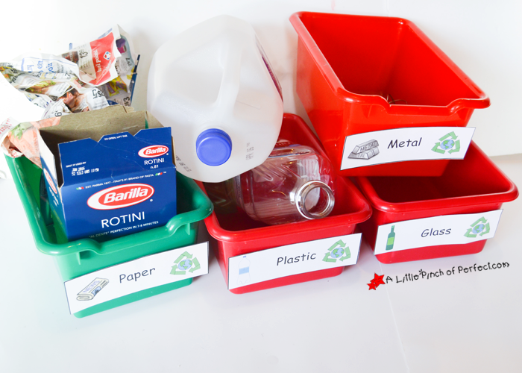
Sorting
Higher Value
Materials uncontaminated
Better for environment and business
Harder to do, but worth the effort
ASK attendant with questions
NEK District does this and one Hauler in CVSWMD

Slide 15

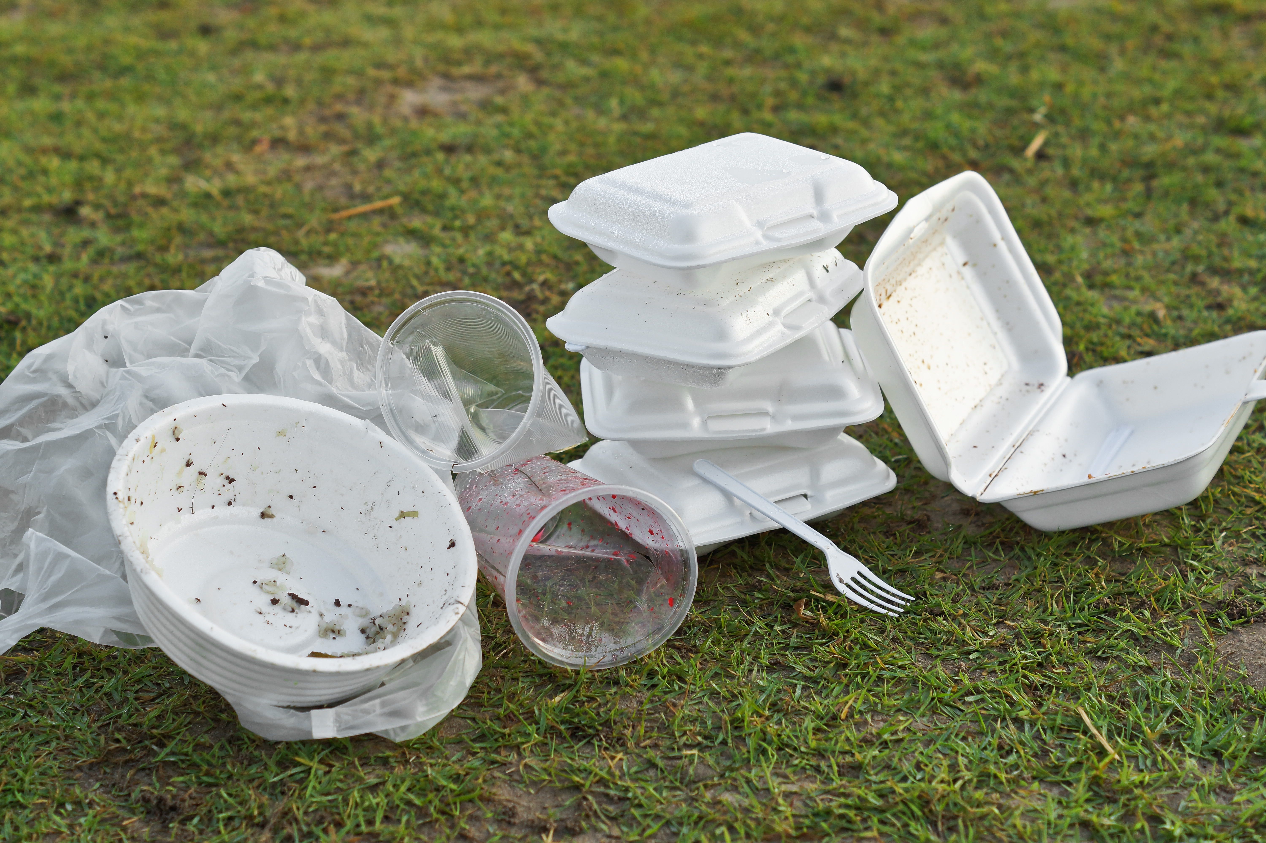
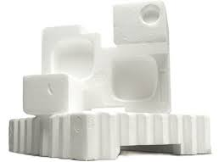
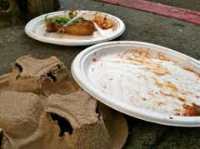
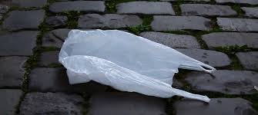


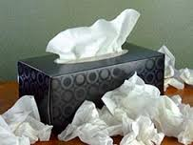
What NOT to Recycle
Styrofoam
Plastic Bags
Food soiled materials
Broken Glass/window glass/cups/tumblers
Any paper that has touched your face (napkins, tissues, paper towels)
Coffee cups
“compostable” dishware
Scrap metal
Smaller than 2” x 2”
Larger than 2’ x 2’

Slide 16
PART THREE
VT Rental Housing Code Updates

Slide 17
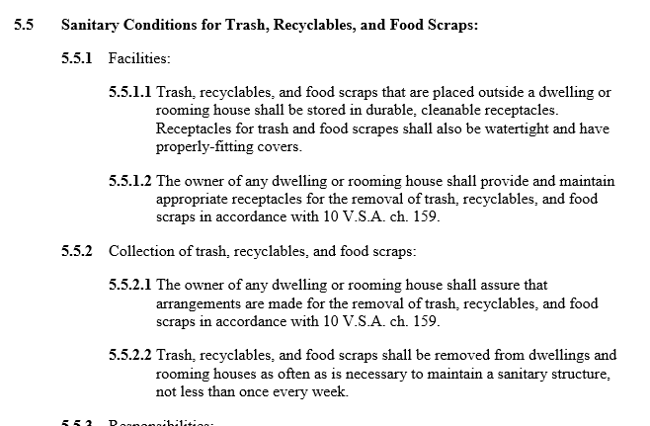
Revised Rental Housing Code

Slide 18
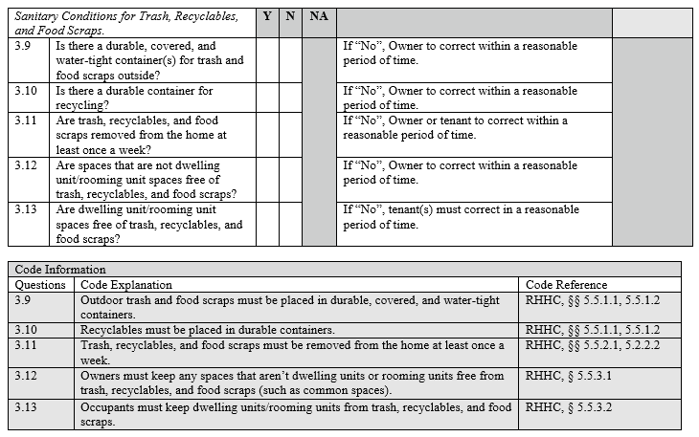
Town Health Officer Rental Code Checklist

Slide 19
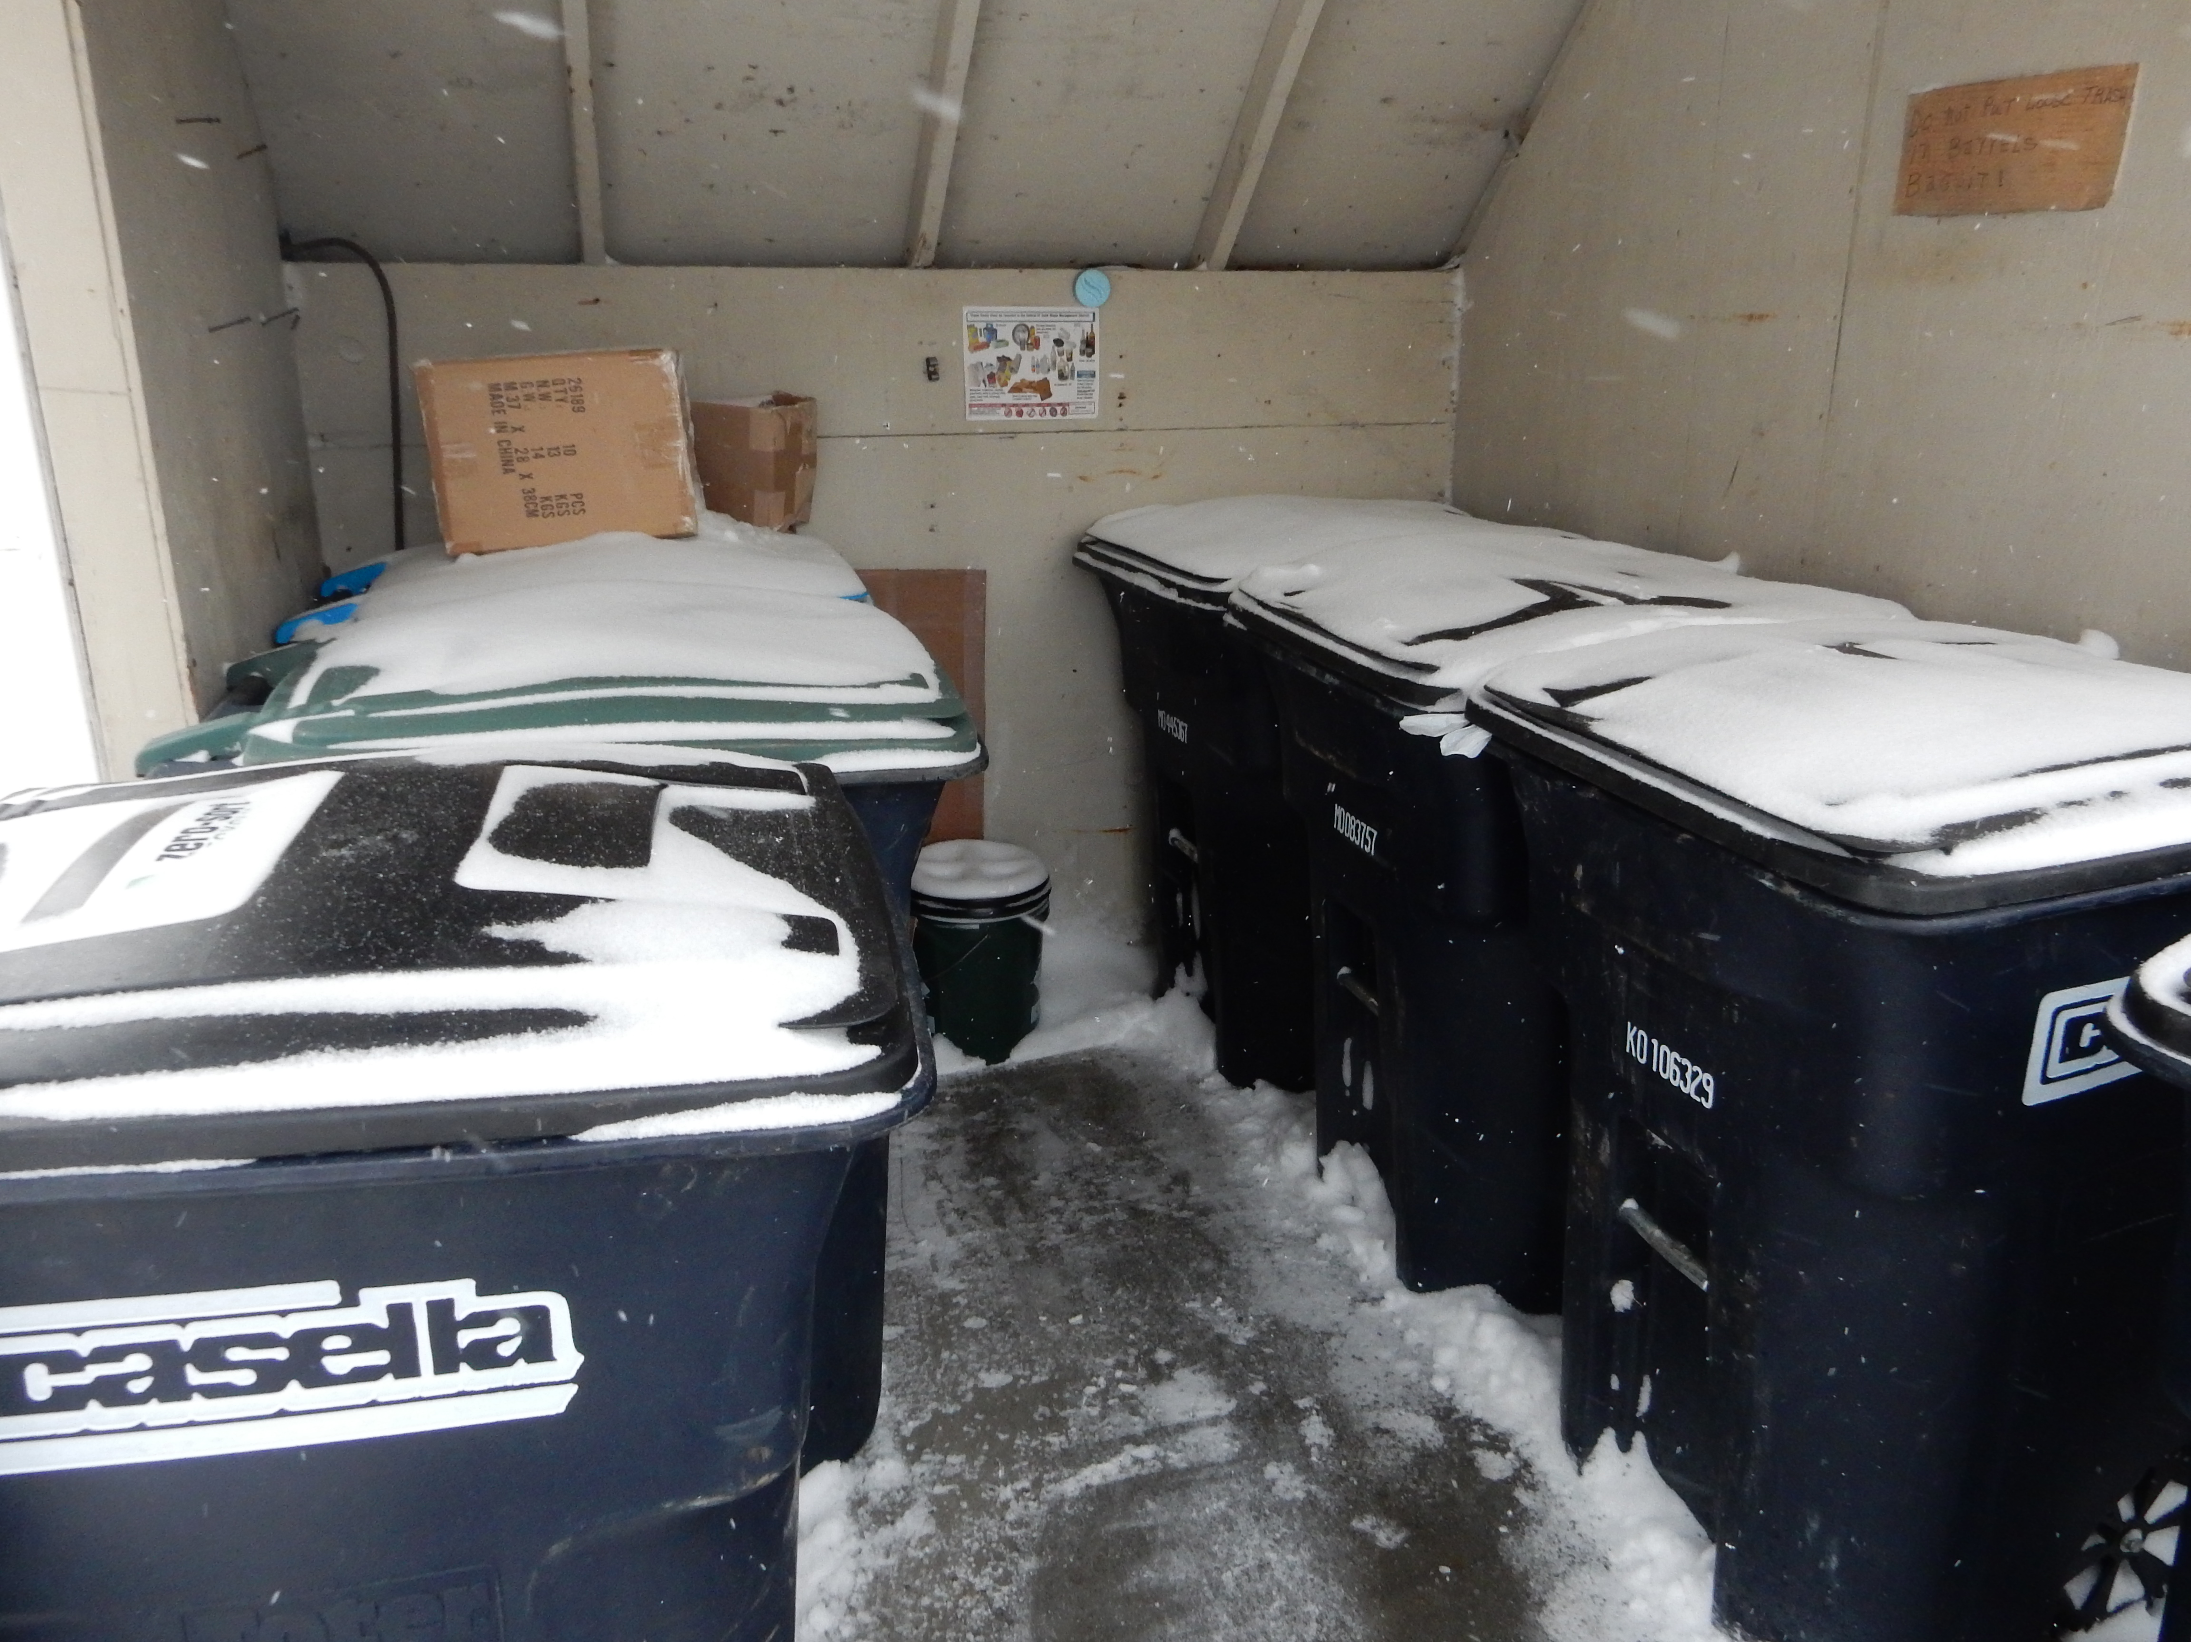
Maple Street Apartments
Clear Signage
Covered/Easy Access
Organized
Watch Out when Trash and Recycling Totes Look the Same

Slide 20
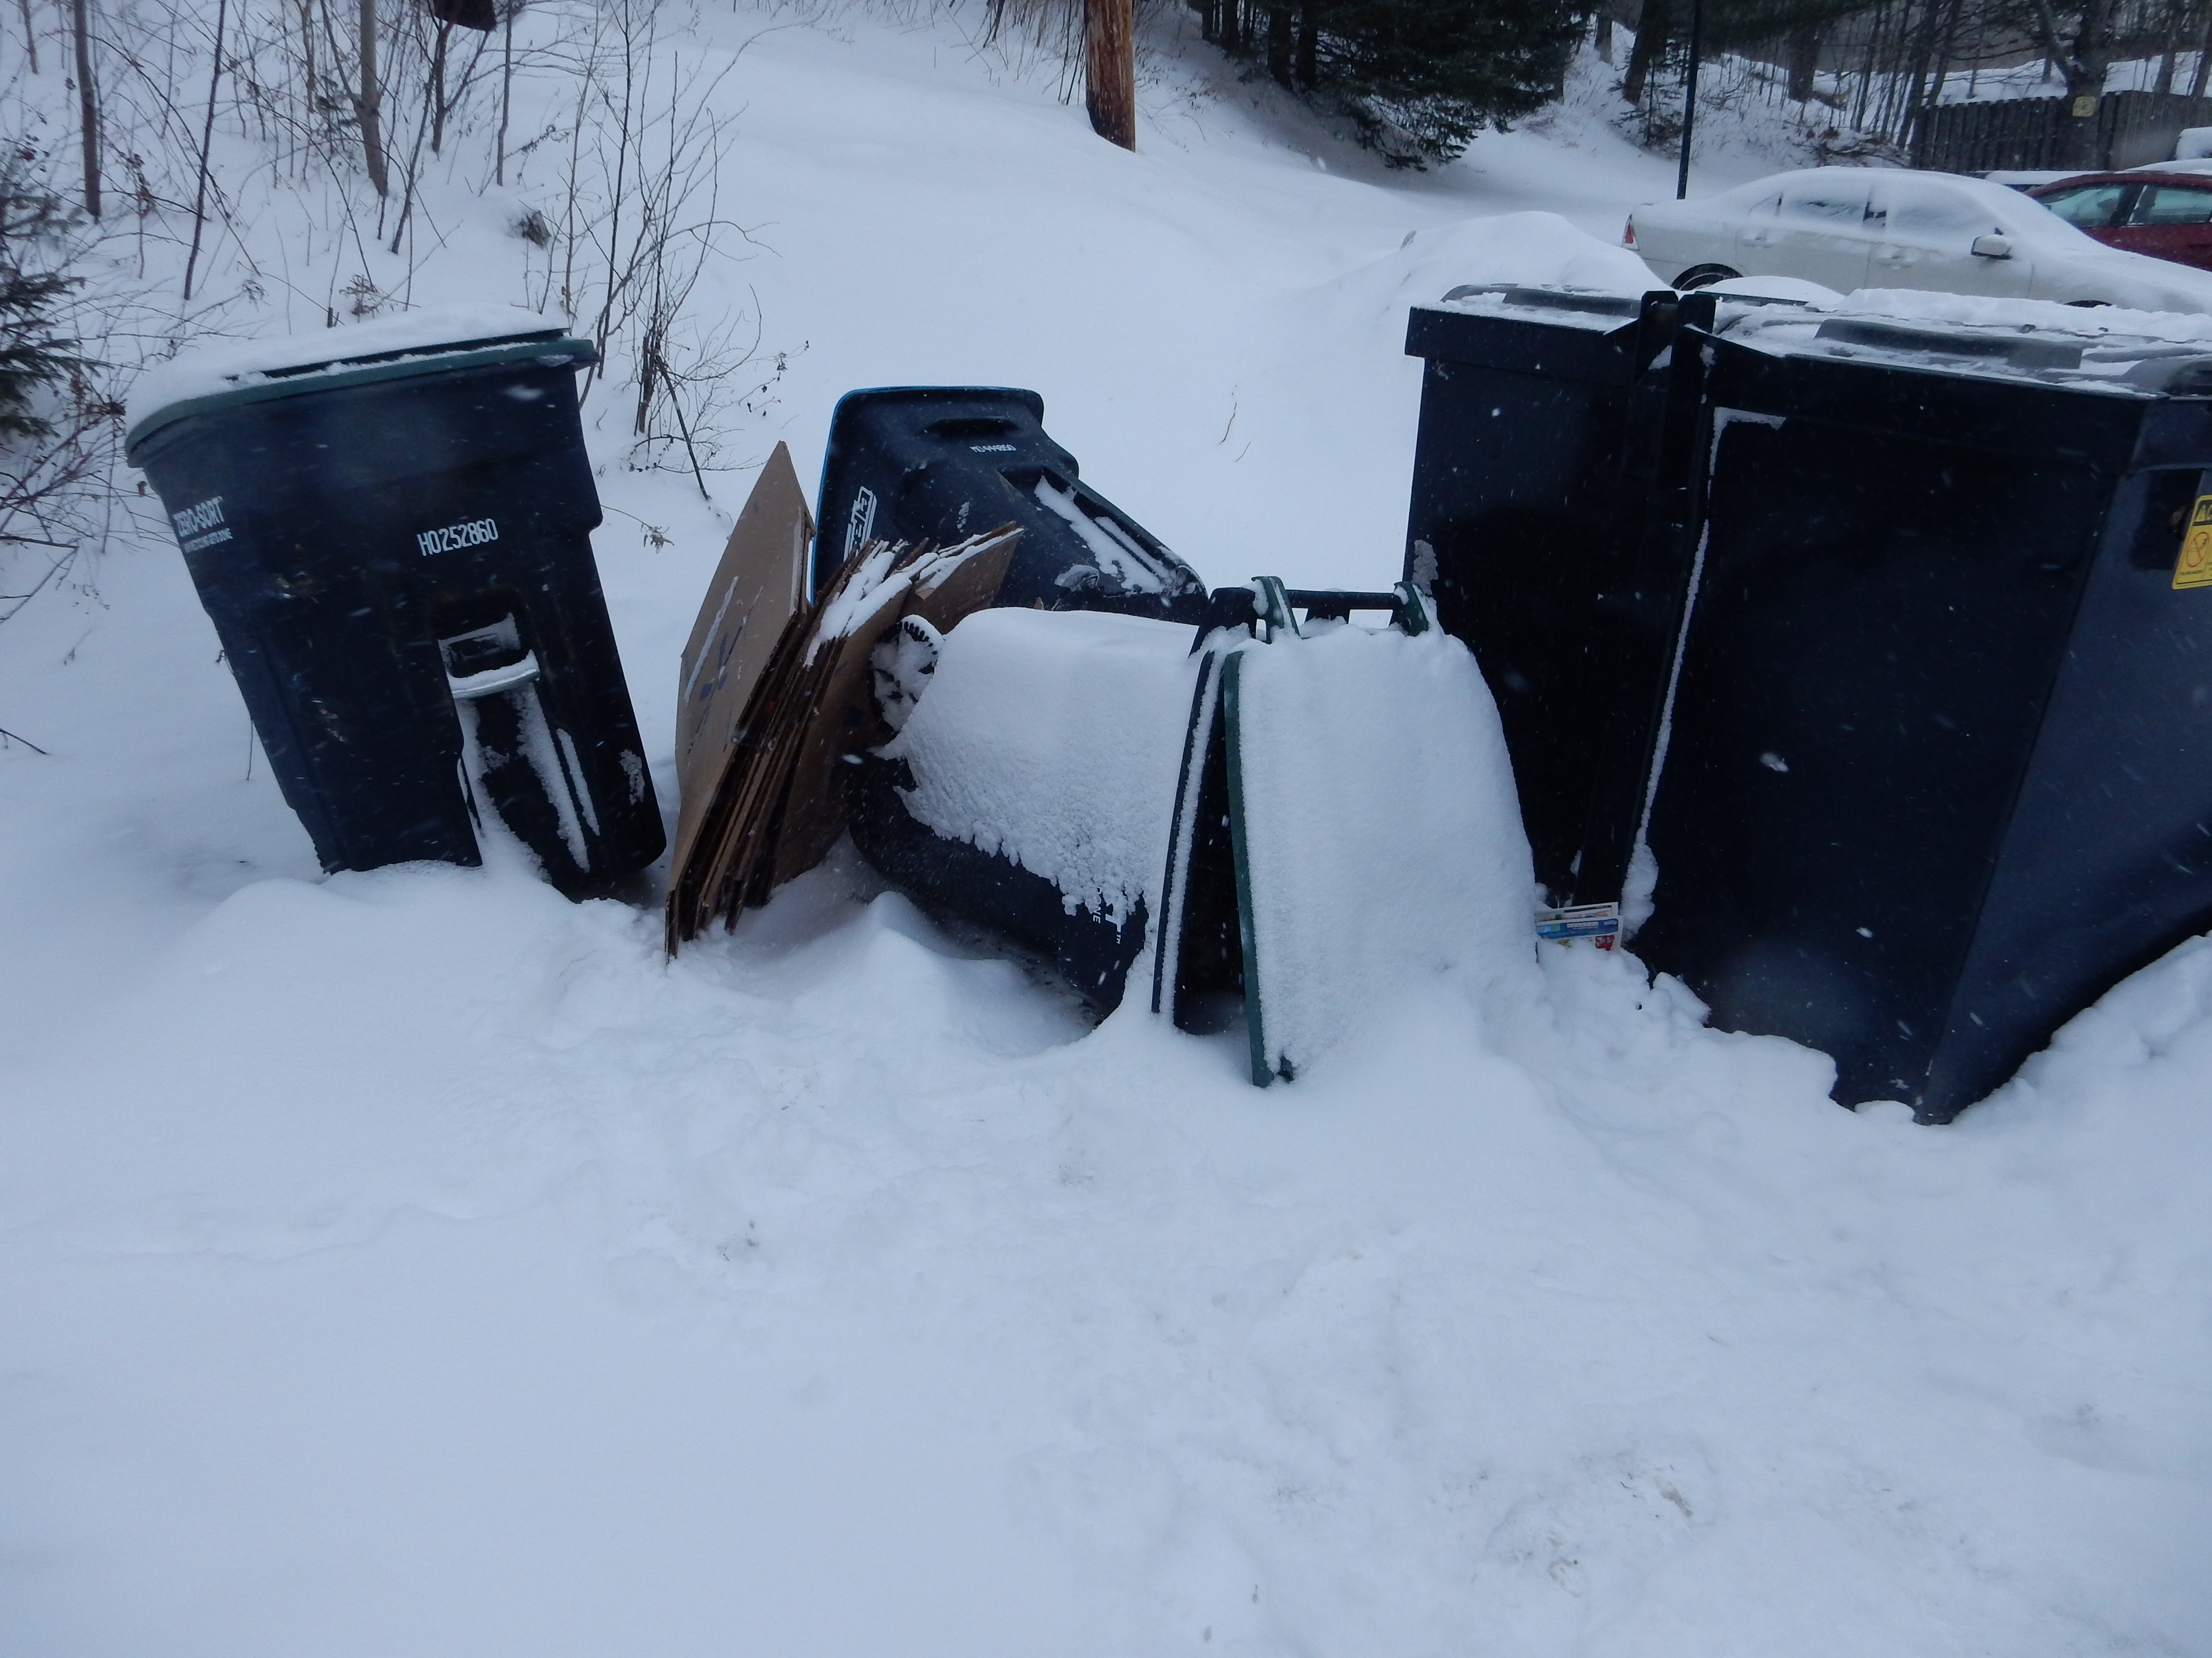
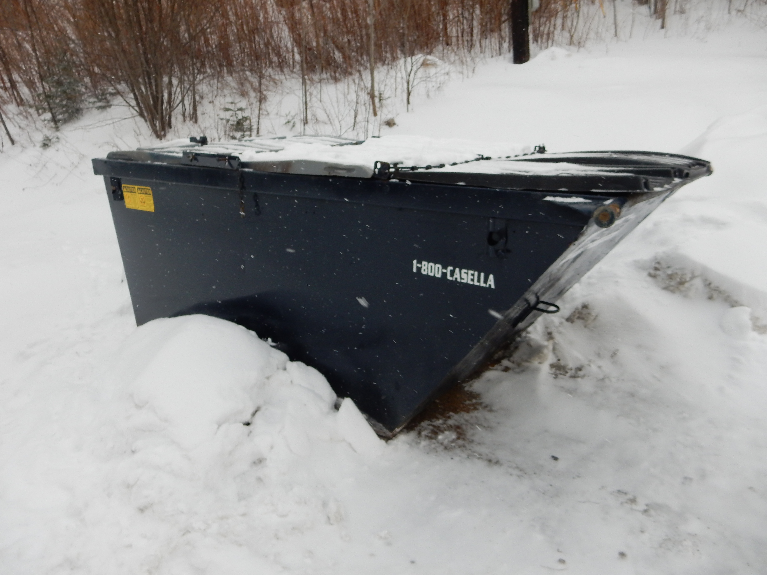
3 Recycle Totes
Large Dumpster
Encourages Trash over Recycling

Slide 21
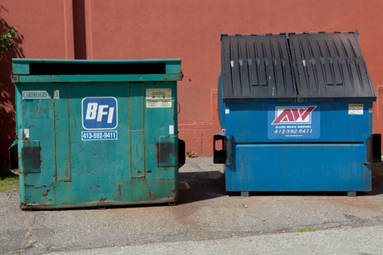
Best Practice
Recycling and Trash Containers Should be the Same Size OR Larger Recycling, smaller trash

Slide 22
PART FOUR
Food Scraps

Slide 23
Universal Recycling Law
By 2020
All Food Scraps Banned from the Landfill

Slide 24
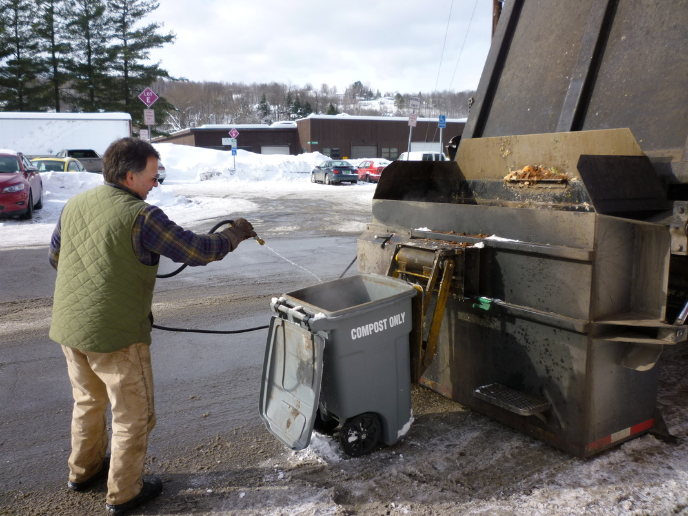
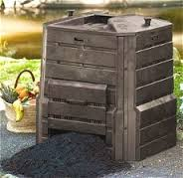
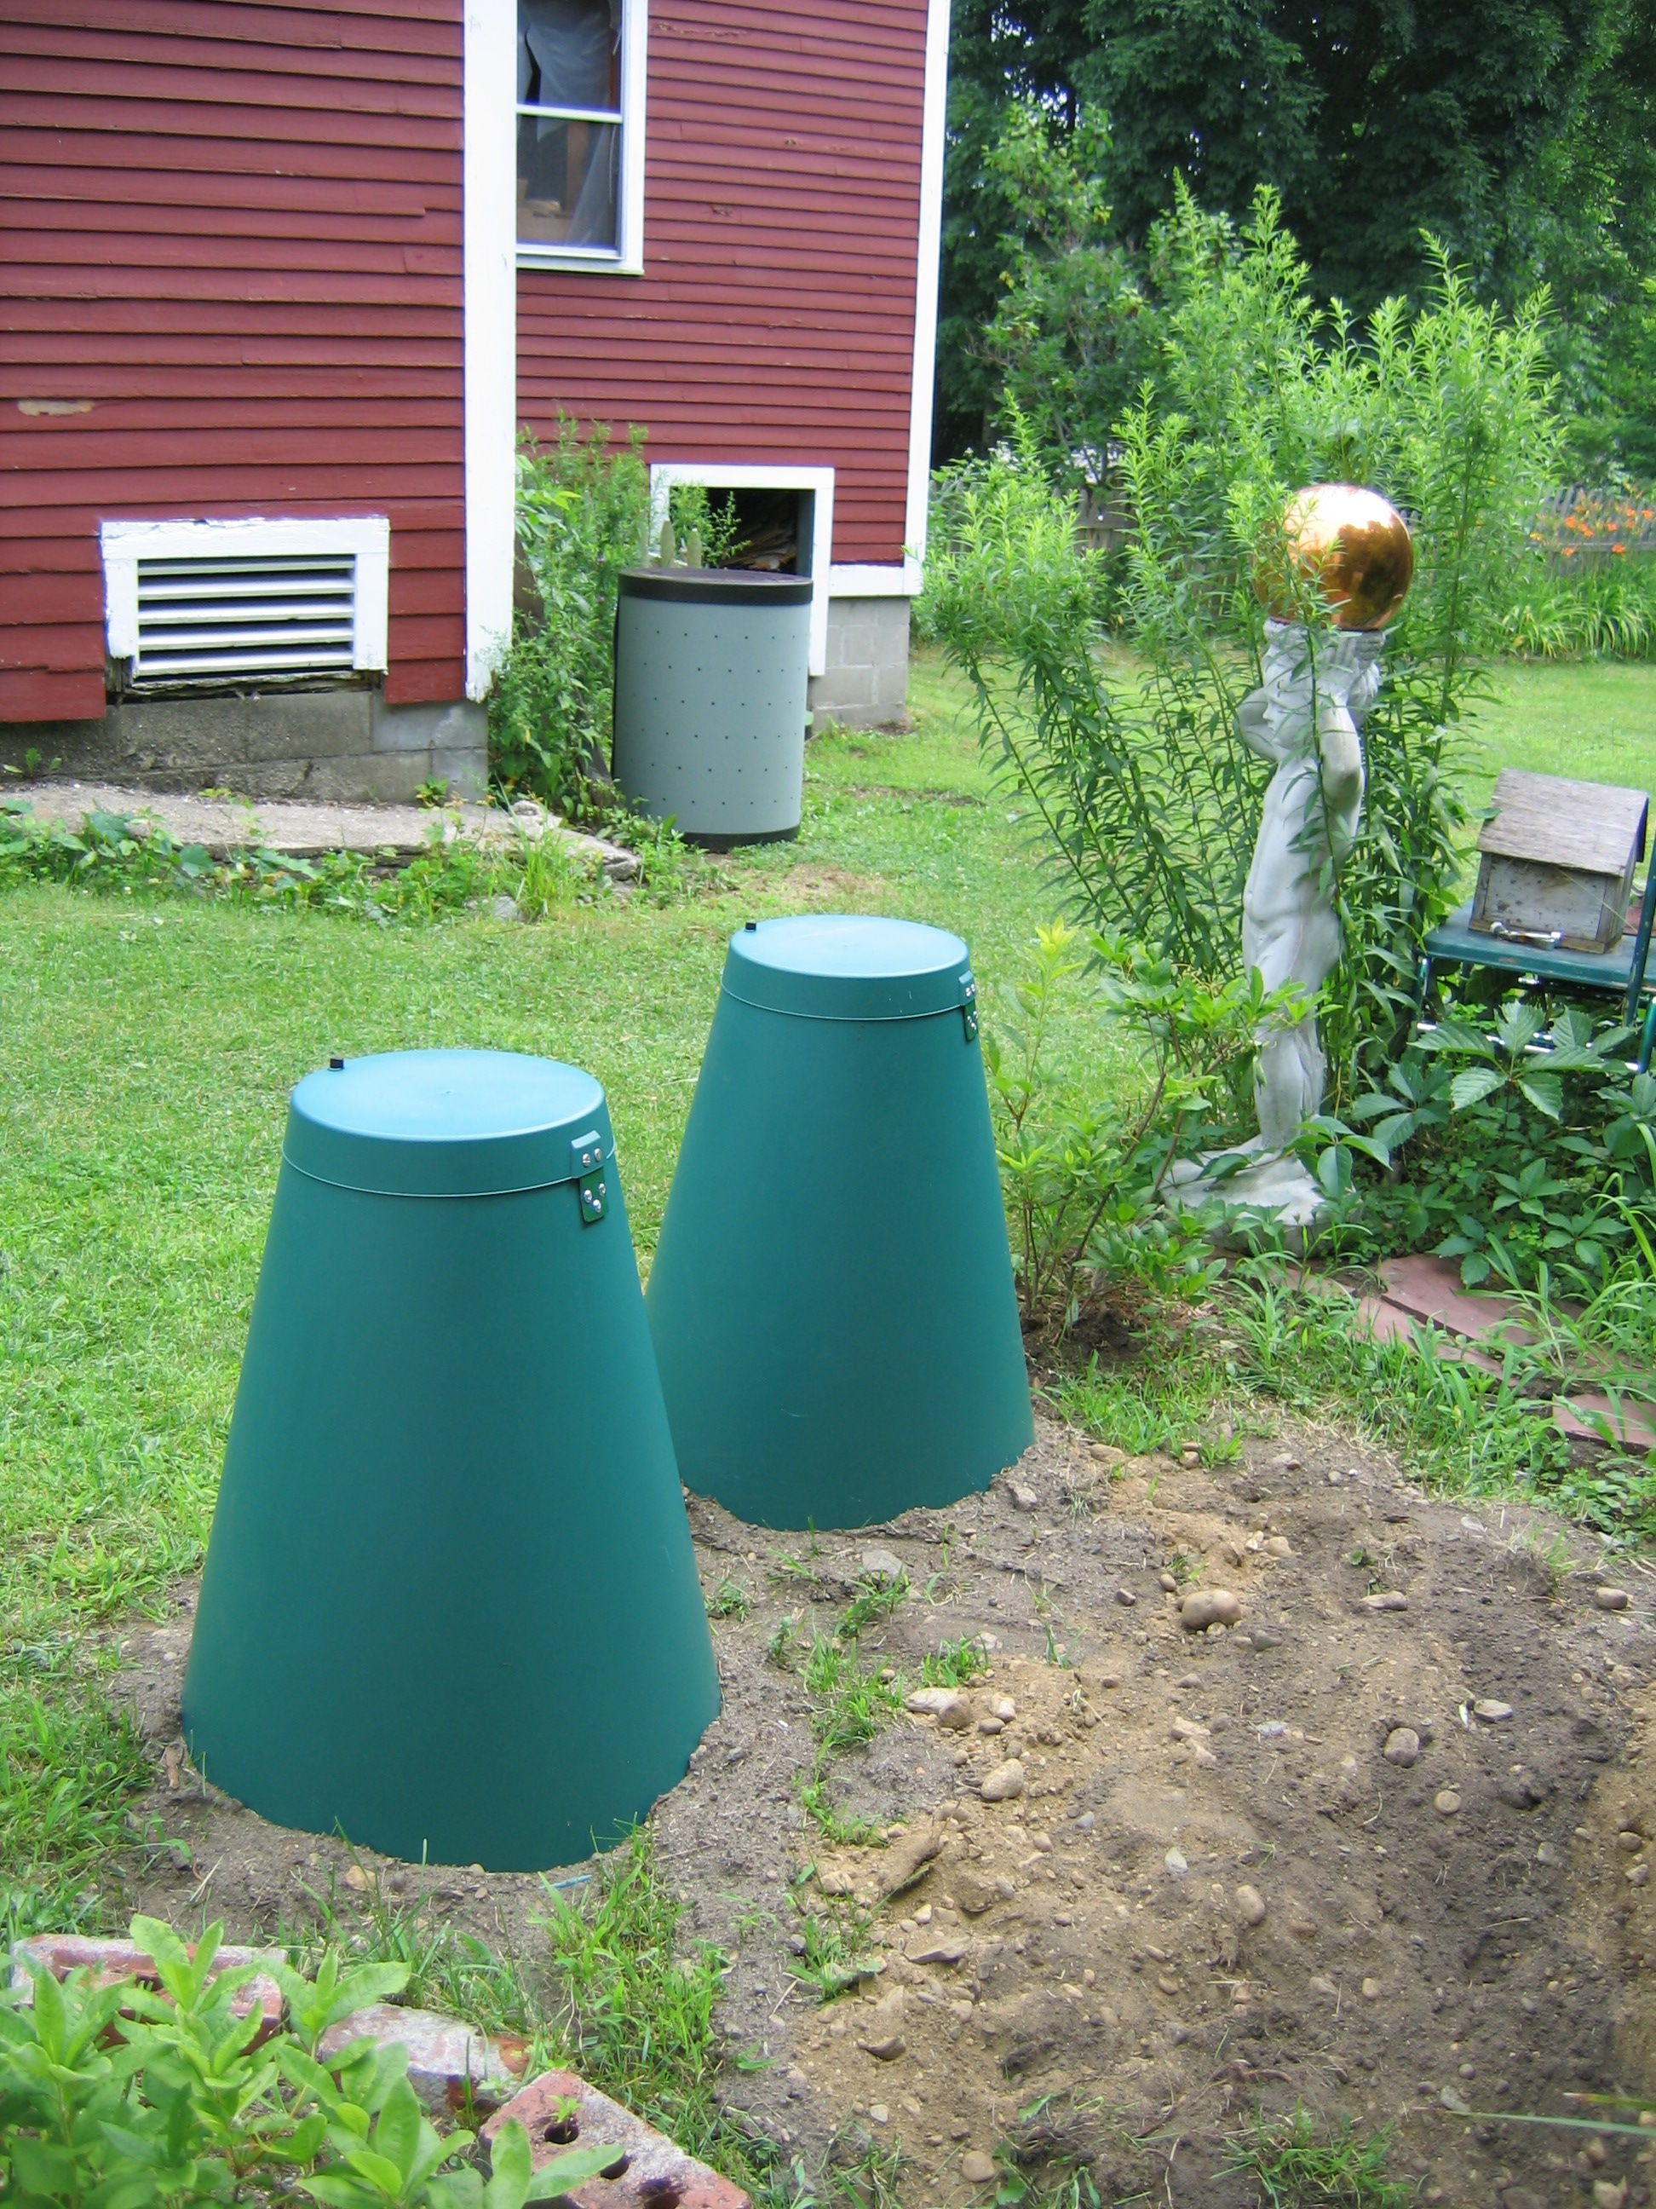
What does this mean for a rental unit?
Tenant Must Be Offered Food Scrap Option
Hauling (similar to recyclables and trash)
Onsite composting if possible

Slide 25
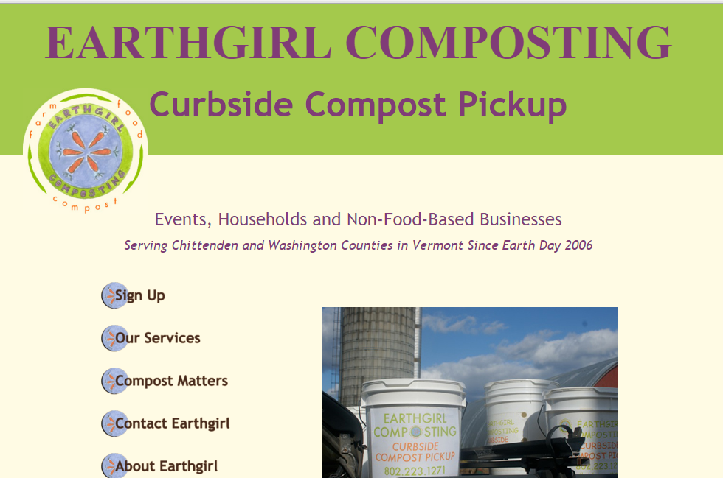
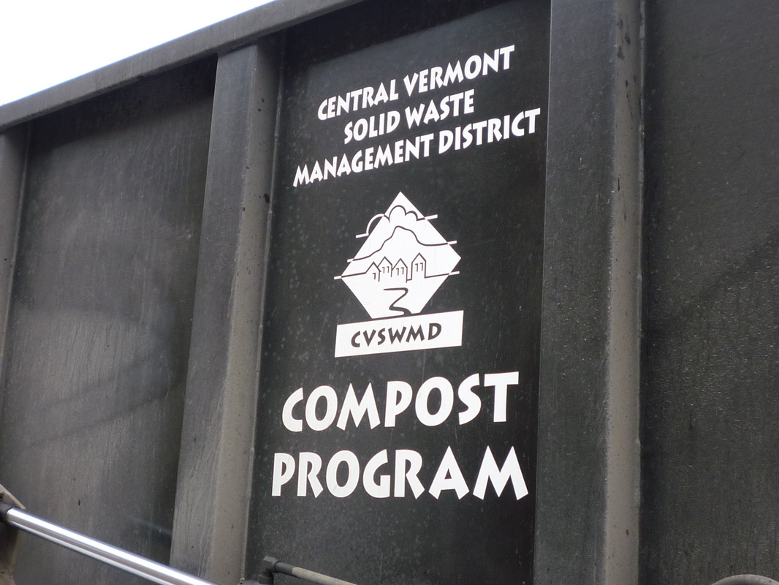
Hauling
Food Scrap Hauling Offered by Haulers in 2017
Currently CVSWMD
Earth Girl Compost
By 2020 likely more

Slide 26
Resources
List of Food Scrap Haulers in Vermont: anr.state.vt.us/dec/wastediv/solid/documents/FoodScrapHaulersSTATEWIDELIST.pdf
List of licensed recycling/trash haulers in central Vermont:
cvswmd.org/licensed-hauler-list.html
Vermont Rental Housing Code:
healthvermont.gov/regs/Rental_Housing_Code.pdf

Slide 27

Questions?
Cassandra Hemenway
802-229-9383 x102
cassandrah@cvswmd.org
cvswmd.org

